Slide 1
Focus on the ATSTN Online Training Platform
June 2023

Slide 2
Overview: Advanced Therapies Skills Training Network
A dedicated skills and training network for advanced therapies and vaccine manufacturing industry.
ATSTN is coordinated by Cell and Gene Therapy Catapult and funded by UKRI and InnovateUK with the aim to attract new talent and upskill the existing workforce within the UK’s advanced therapies and vaccine manufacturing industry.
Our Skills Demand surveys in 2019 and 2021 identified a large skills gap – the industry is growing at a fast pace and there just aren’t enough skilled people to fill the anticipated jobs over the next 5 years.
So ATSTN was established as part of an integrated skills programme to address the skills gap. We currently do this in three ways:
Online Training Platform
National Training Centres
Career Converter tool
Online Training Platform
Easy to access catalogue of training content and resources
National Training Centres
Delivering training across the UK
Career Converter
AI & data science tool to match transferable skill set with in-demand job roles

Slide 3
ATSTN Offering
Online Training Platform
Online catalogue of industry-recommended training:
Over 800 courses from 38 training partners
Range of scientific, technical and personal development content
Training for every budget
Immersive Learning
Explore the potential of virtual and augmented reality training solutions.
See examples we’ve developed to showcase the technology and deployed to learners
National Training Centres
In-person training courses across the UK
Essential hands-on training covering manufacturing, GMP/GxP and bioprocessing
Career Converter
Measure your skillset against in-demand job roles
Discover career and development options in advanced therapies

Slide 4
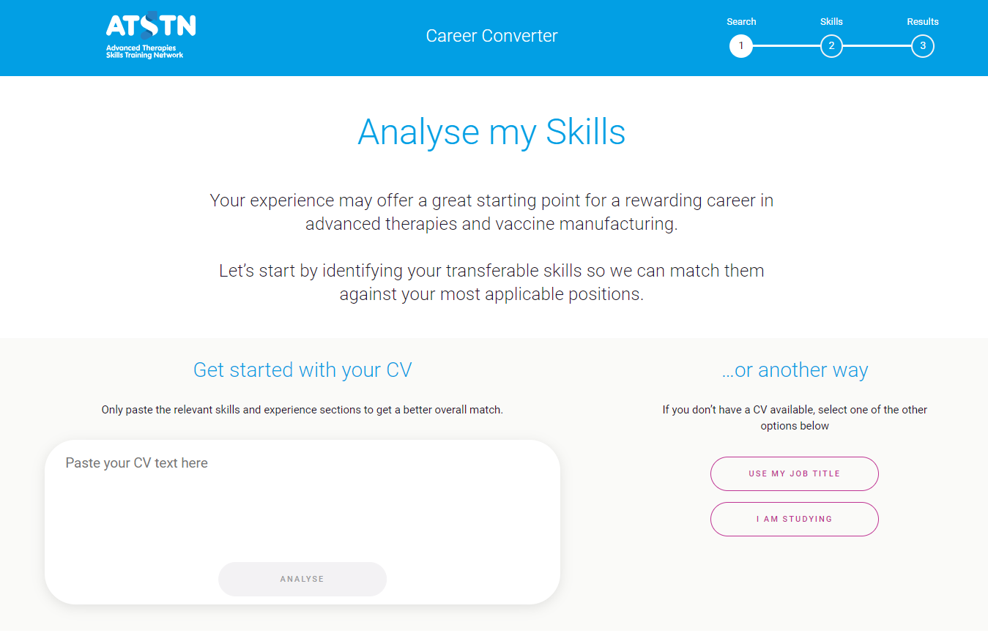
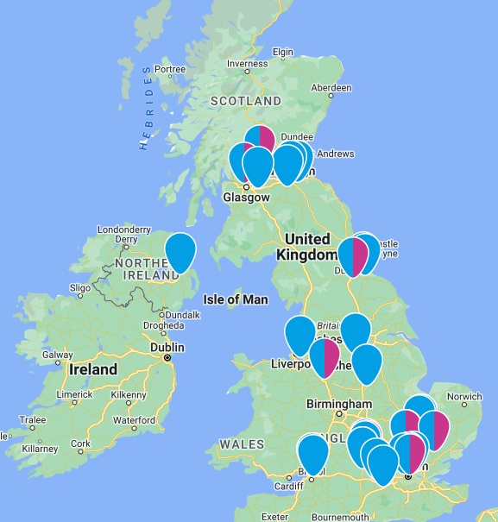
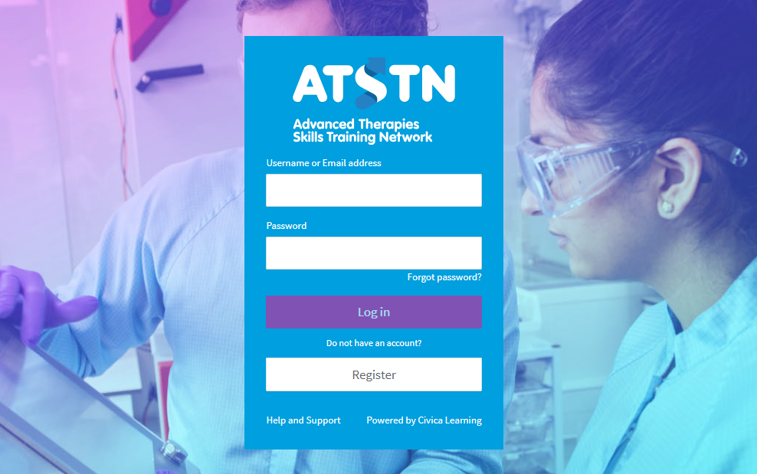
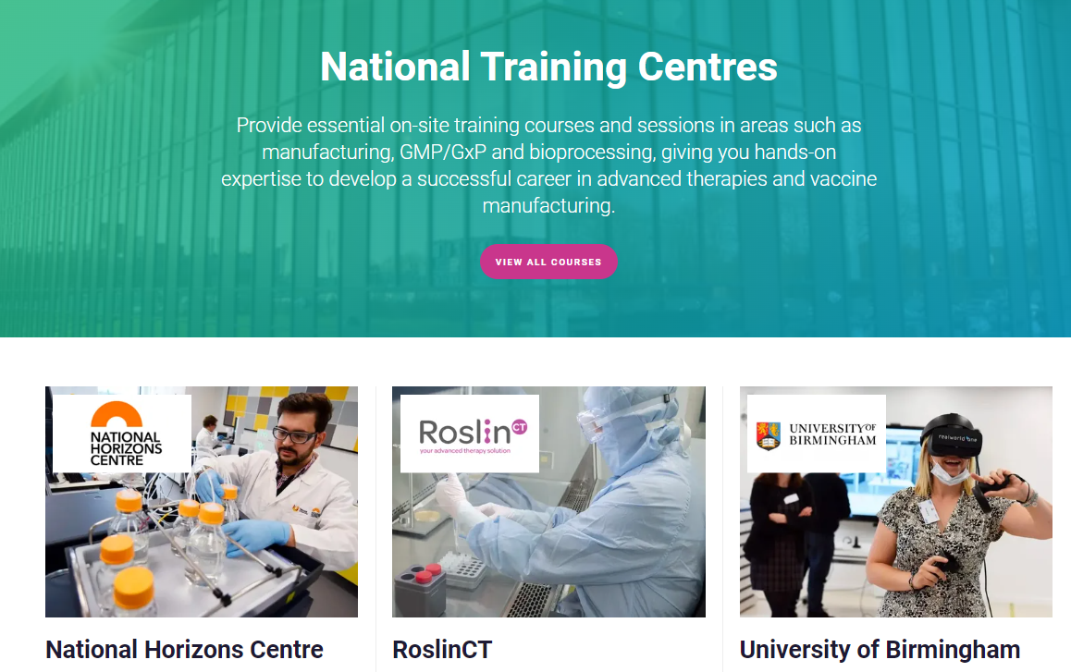
ATSTN User Journey
Whether you are new to the industry, work in a non-scientific role or have years of experience, there are always opportunities to learn…
Career Converter
Partners Map
Online Training Platform
National Training Centres
Match your skills against in-demand job roles
Find potential job roles from your results
Find employers and vacancies in your area
Explore training options on OTP using Learner Pathways to find relevant courses
Enrol at one of the National Training Centres to develop your skills further
Try out some free courses or enrol with one of our training partners

Slide 5

Take a look at the Online Training Platform
Hover on the image to play the video

Slide 6
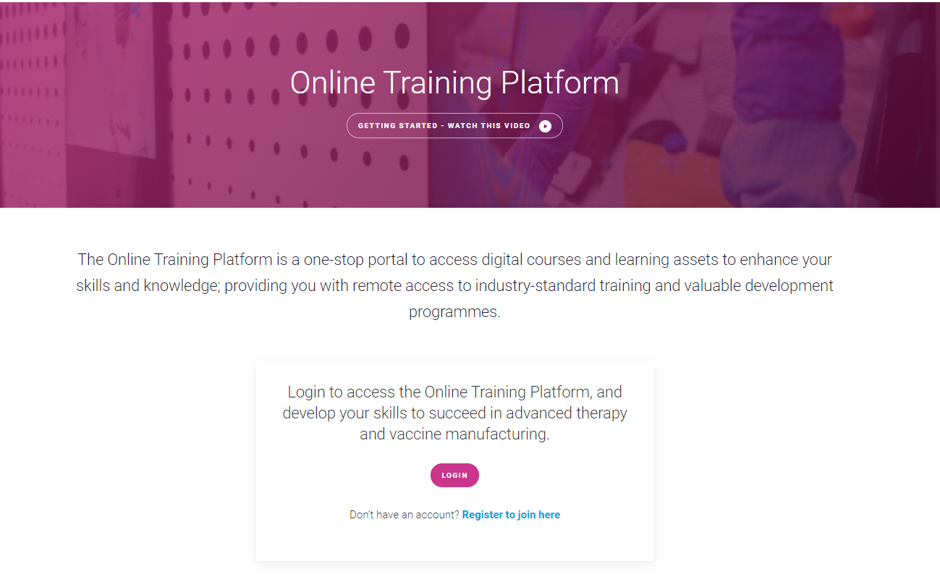
Accessing the Online Training Platform: Individuals
Access is free for UK residents already working across or interested in joining the advanced therapies and vaccine manufacturing industry.
Register through the ATSTN website by clicking on the Online Training Platform page and ‘register’ option next to the login button.
Alternatively, go straight to the registration form below.
https://www.atskillstrainingnetwork.org.uk/request-access-to-the-otp/
After your registration form is submitted, you will receive an email with your login details within 2 working days.

Slide 7
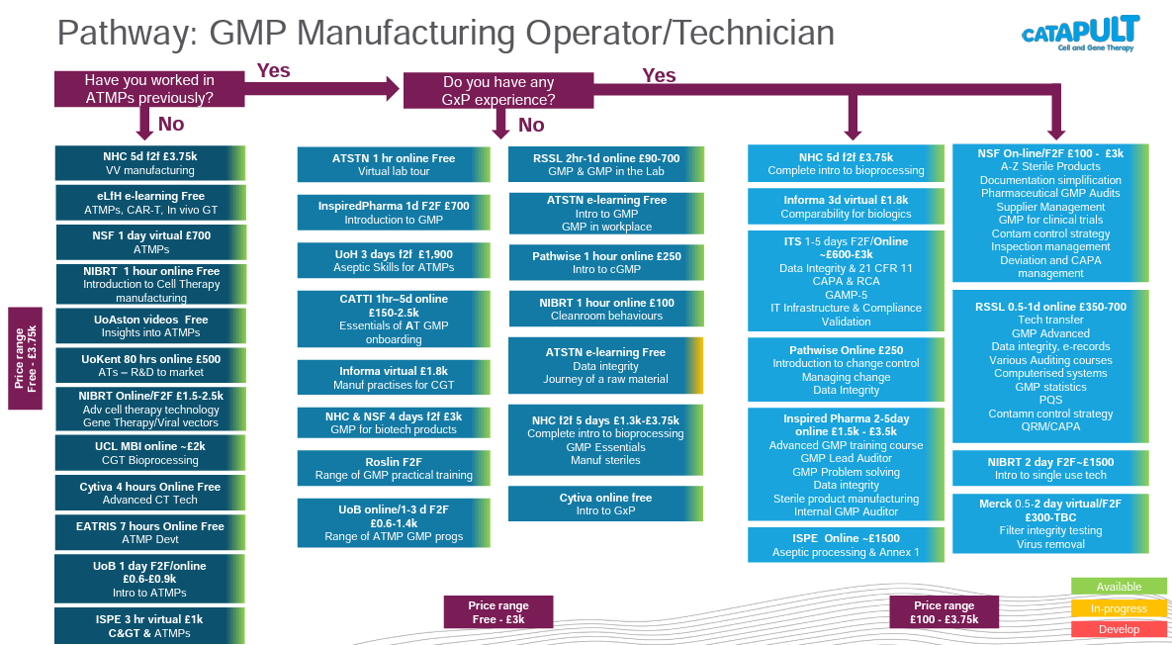
Learner Pathways
To help navigate through the courses on the Online Training Platform and find the ones relevant to your current or potential job role, we developed a series of Learner Pathways.
They feature a simple flow-chart to gauge your experience level and list all of the relevant courses on the platform for that job role. This narrows down the most relevant courses and you can then use the platform to explore the suggested courses in more detail and see which is most suitable for you.
https://www.atskillstrainingnetwork.org.uk/learner-pathways/
You can also access the Learner Pathways via the Support & Help pages on the platform.

Slide 8
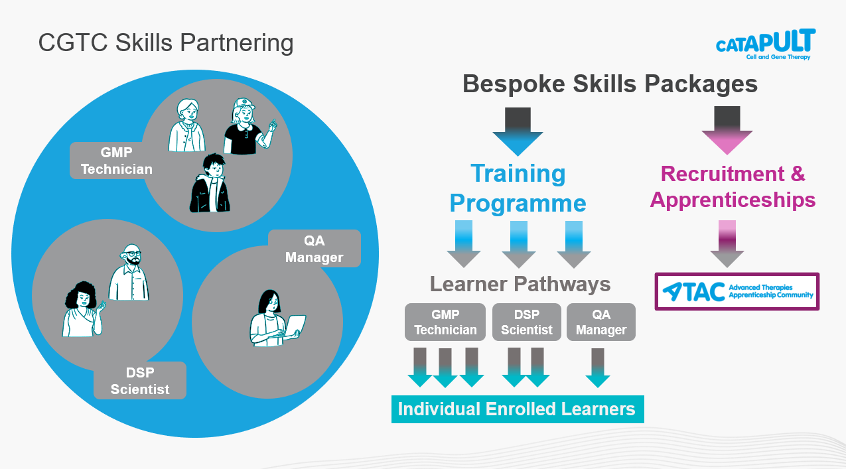
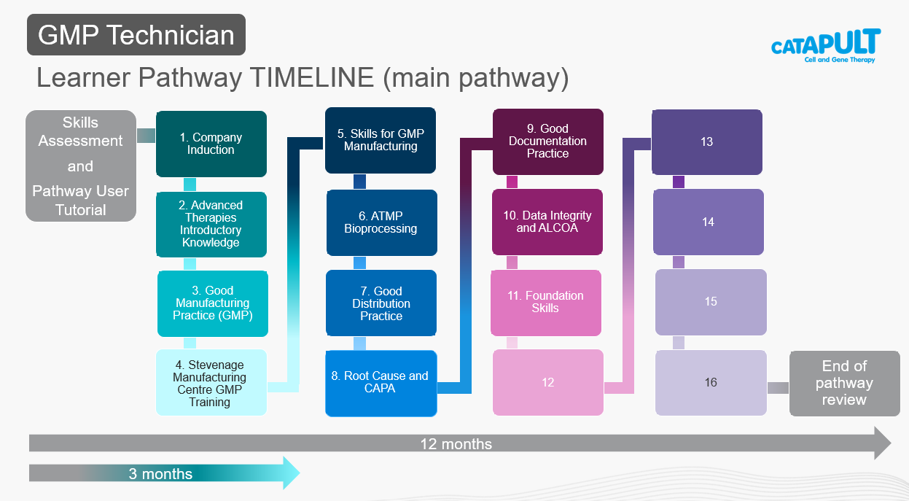
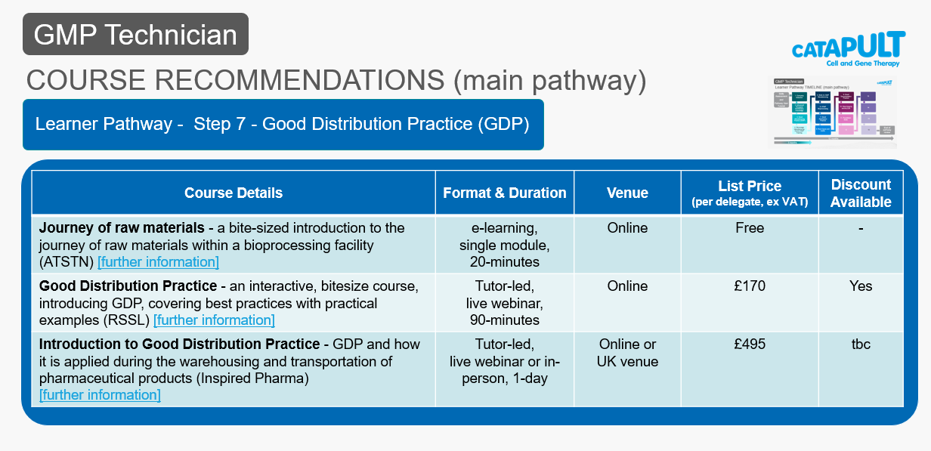
Online Training Platform for Employers
The ATSTN team are experienced L&D professionals who can work with you to find the ideal learning solution for your organisation.
We offer:
bulk enrolments to roll out the platform to your employees
bespoke programmes on the platform containing your choice of courses
bespoke learner pathways for specific job roles
reporting options
apprenticeship support through our Advanced Therapies Apprenticeship Community (ATAC)
Contact the team to discuss your requirements:
atskills.support@ct.catapult.org.uk

Slide 9
Frequently Asked Questions
What content is on OTP?
There are various learning options available across manufacturing, technical, equipment and processes, quality, regulatory, leadership and compliance, just to name a few topics. Content includes access to commercial instructor-led face to face and online courses, eLearning modules, podcasts, webinars, videos, webinars and more. New content is frequently added to reflect role and industry needs.
Do I have to pay for the courses?
Around 50% of the content is free of charge, whilst the rest have a cost associated. The courses and digital learning assets that are hosted on the platform are free to users. The courses that have a cost are generally those which lead you to external websites, and are provided by our training partners.
What will happen if I register and then don’t use the platform?
The ATSTN team reviews user activity periodically and will contact the individual if they do not use the platform to see if they need help accessing the platform or confirm if they no longer wish to use it. If no response is received or no activity take place for 12 months or longer, the account will be deactivated.

Slide 10
Frequently Asked Questions
How have the courses on OTP been identified?
The existing content has been recommended by the you, the industry. We undertook a survey with organisations within the industry to understand the training landscape and the courses/programmes that you would recommend. Based on the priority skills gaps identified within the Skills Demand Survey and your recommendations, content and signposting to suitable programmes have been published on the OTP.
ATSTN is not a training provider, we aim to make training accessible and strengthen our industry’s training infrastructure. If there are any courses, programmes or resources that you would like to recommend that are not on OTP, please let us know!
If I have a technical issue, who do I contact?
If you need a password reset, you can do this from the login page. Click on the ‘Forgotten password?’ link and follow the instructions. You will be sent an automated email that enables you to reset your password.
For technical issues, contact the ATSTN team at atskills.support@ct.catapult.org.uk

Slide 11
Frequently Asked Questions
How do I download the App?
The ATSTN App is available on Apple or Android phones, offering convenience and flexibility in when and how you learn. Go to your Apple App Store or Google Play on your device and search for ‘ATSTN online training platform’ and then follow the instructions to install. Your username and password is the same across any device.
Who is the supplier for the Learning Management System of OTP?
Agylia, currently being re-branded as Civica Learning.
Who do I contact with queries about OTP?
You can contact the ATSTN Team at atskills.support@ct.catapult.org.uk

